Slide 1
Non-parametric Statistics
RADI 5007 , Spring 2018
Tom Vanasse

Slide 2
Slides/Code
https://github.com/tvanasse/Class-Demo-6-30-18

Slide 3
Overview
• Scales of measurements
• McNemar test for paired data
• Mann-Whitney U test
•Wilcoxon signed rank test
• Sign test

Slide 4
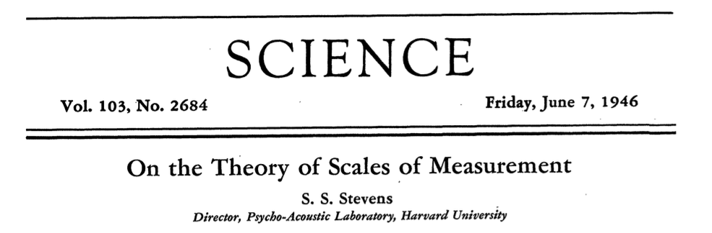

Slide 5
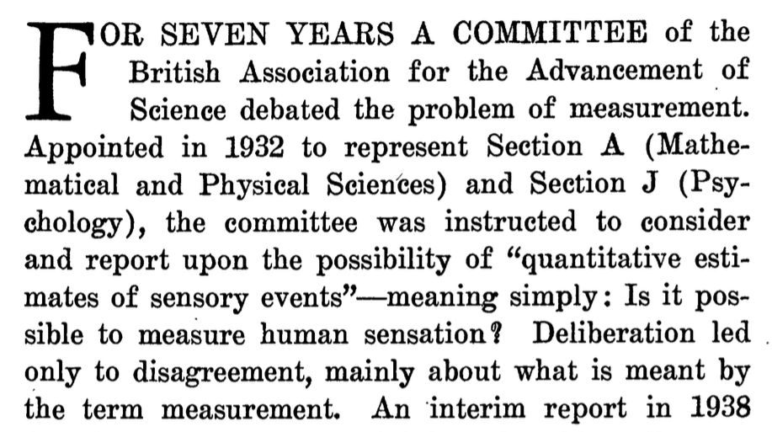

Slide 6
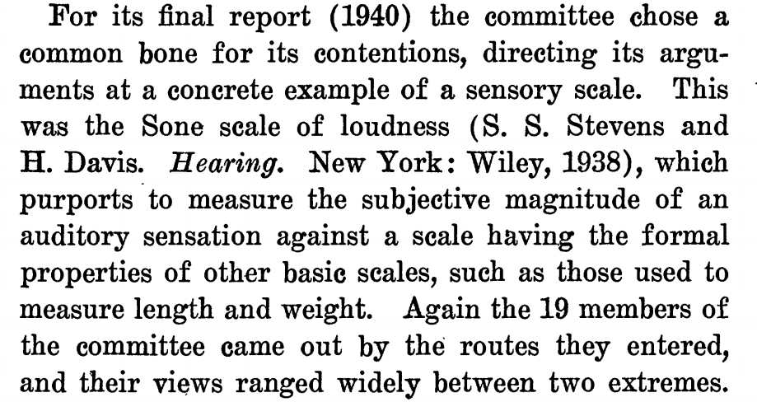

Slide 7
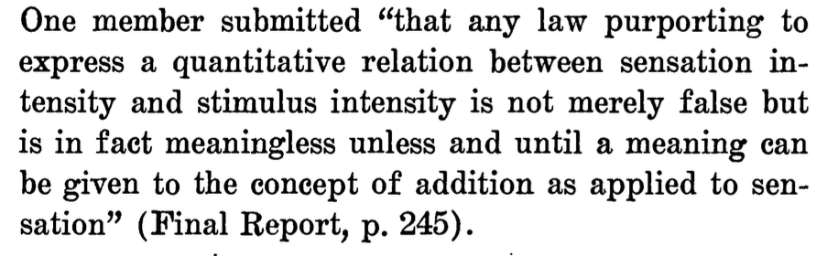

Slide 8
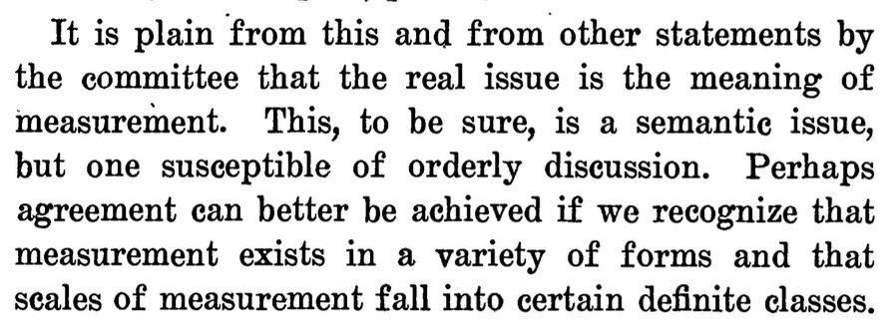
Classes of Measurements

Slide 9
Interval Data
– ordered, constant scale, but no zero
– differences make sense, but ratios do not (e.g., 30°-20°=20°-10°, but 20° is not twice as hot as 10°)!
– e.g., temperature (C,F), dates

Slide 10
Ratio Data
– ordered, constant scale, natural zero
– e.g., height, weight, age, length

Slide 11
Ordinal Data
ordered but differences between values are not important
– e.g., political parties on left to right spectrum given labels 0, 1, 2
– e.g., Likert scales, rank on a scale of 1 to 5 your degree of satisfaction
– e.g., restaurant or movie ratings

Slide 12
Nominal Data
– classification data, e.g. m/f
– no ordering, e.g. it makes no sense to state that M > F
– arbitrary labels, e.g., m/f, 0/1, etc.
- You are only allowed to examine if a nominal scale datum is equal to some particular value or to count the number of occurrences of each value.

Slide 13
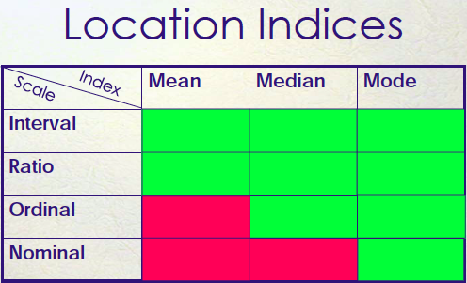

Slide 14
Assumptions of Parametric Statistics
- Data are continuous
- Data are normally distributed
- When these conditions do not apply we have to find other, non-parametric testing methods

Slide 15
Spearman Rank Correlation
- Spearman Rank Correlation Coefficient
- Used to determine correlation when data is distributed normally along ordinal scales
- Value of variables are ranked in ascending order, where d = differences in rank.
- Equation similar to Pearson then applies:

Slide 16
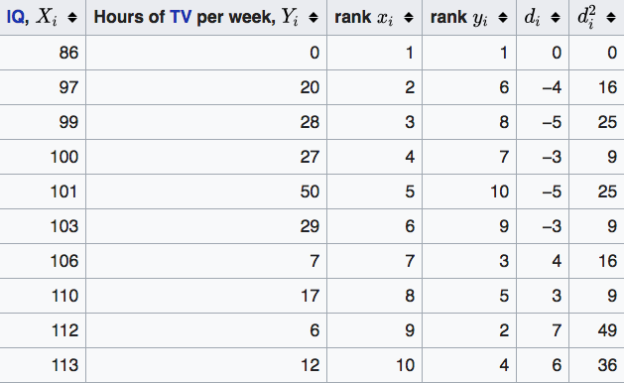
Example from last lecture…
−0.175

Slide 17
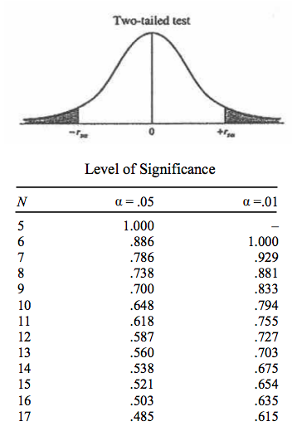
Critical Value
Line 10

Slide 18
Contingency Tables
- Used when looking at the relationship between two nominal or ordinal variables.
- Also used with interval or ratio variables if the interval or ratio variables are broken into categories and the categories are used as nominal or ordinal variables.
– Example: a new group of variables that categorizes height as short, average, or tall.

Slide 19
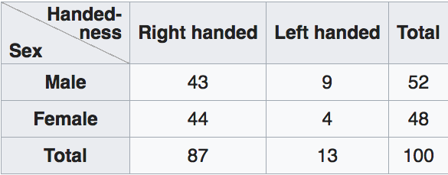
https://en.wikipedia.org/wiki/Contingency_table

Slide 20
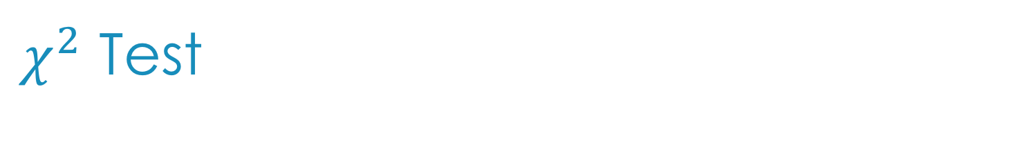
$χ^{2}$ Test
Pearson's chi-squared test (χ2) is a statistical test applied to sets of categorical data to evaluate how likely it is that any observed difference between the sets arose by chance.
A test of goodness of fit establishes whether an observed frequency distribution differs from a theoretical distribution.
A test of homogeneity compares the distribution of counts for two or more groups using the same categorical variable
A test of independence assesses whether unpaired observations on two variables, expressed in a contingency table, are independent of each other

Slide 21
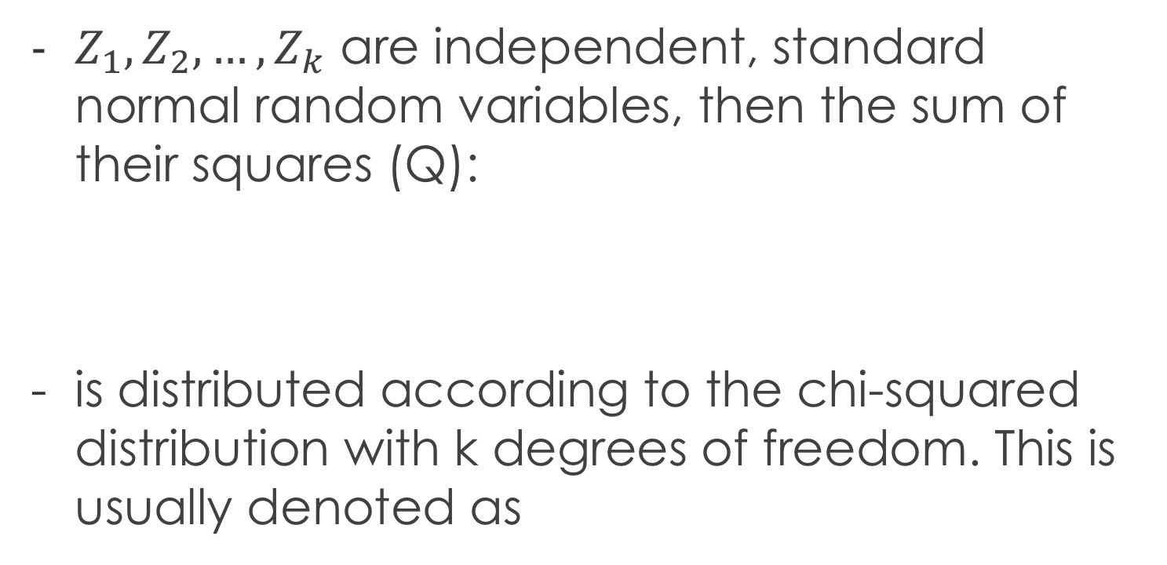
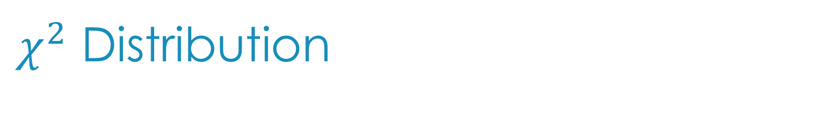
$χ^{2}$ Distribution
$Z_{1}, Z_{2},…, Z_{k}$ are independent, standard normal random variables, then the sum of their squares (Q):
is distributed according to the chi-squared distribution with k degrees of freedom. This is usually denoted as

Slide 22

$χ^{2}$ Distribution
Probability density
k = degrees of freedom

Slide 23
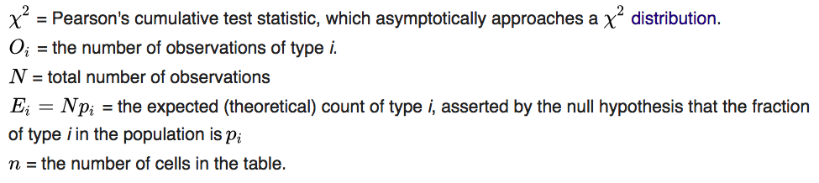
Calculating the test-statistic
https://en.wikipedia.org/wiki/Chi-squared_distribution

Slide 24
Calculate p-value
The chi-squared statistic can then be used to calculate a p-value by comparing the value of the statistic to a chi-squared distribution.

Slide 25
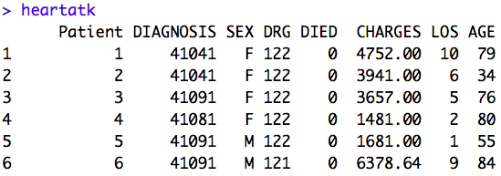
Example
This set of data is all of the hospital discharges in New York State with an admitting diagnosis of an Acute Myocardial Infarction (AMI), also called a heart attack, who did not have surgery, in the year 1993. There are 12,844 cases.

Slide 26
Example
Research question: Are frequency of deaths resulting from heart attacks in males and females different?
Test of Homogeneity

Slide 27
 | Lived | Died | Total
Male | 4,298 | 767 | 5,095
Female | 7,136 | 643 | 7,779
Total | 11,434 | 1,410 | 12,844
Calculate df:
df = (r-1)*(c-1) = 1
Calculate Expected frequency counts given null
hypothesis:
E_{r,c} = (n_{r} * n_{c}) / n

Slide 28
Calculating Expected values
 | Lived | Died | Total
Male | 4,298 | 767 | 5,095
Female | 7,136 | 643 | 7,779
Total | 11,434 | 1,410 | 12,844
Observed
- The null hypothesis states that the proportion of men who die is identical to the proportion of women of die.
E_{1,1} = (n_{r=1} * n_{c=1}) / n = (5,095*11,434)/12,844 = 4,535
E_{2,1} = (n_{r=2} * n_{c=1}) / n = (7,779*11,434)/12,844 = 6,925
E_{1,2} = (n_{r=1} * n_{c=2}) / n = (5,095*1,410)/12,844 = 559
E_{2,2} = (n_{r=2} * n_{c=2}) / n = (7,779*1,410)/12,844 = 1,583
 | Lived | Died | Total
Male | 4,535 | 559 | 5,095
Female | 6,925 | 1,583 | 7,779
Total | 11,434 | 1,410 | 12,844
Expected

Slide 29
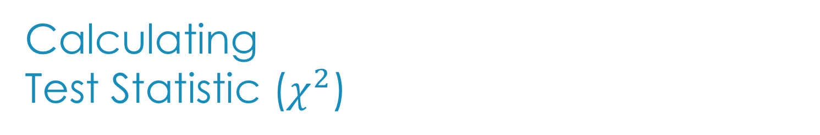
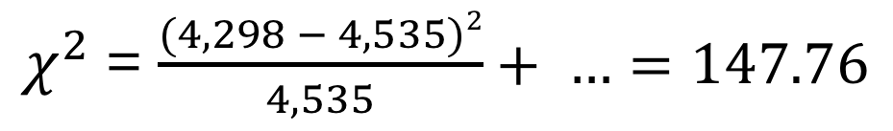
Calculating Test Statistic ($χ^{2}$)
 | Lived | Died | Total
Male | 4,298 | 767 | 5,095
Female | 7,136 | 643 | 7,779
Total | 11,434 | 1,410 | 12,844
Observed
$χ^{2}$= $\frac{(4,298 − 4,535)2}{4,535}+ …=147.76$
 | Lived | Died | Total
Male | 4,535 | 559 | 5,095
Female | 6,925 | 1,583 | 7,779
Total | 11,434 | 1,410 | 12,844
Expected
Line 30

Slide 30
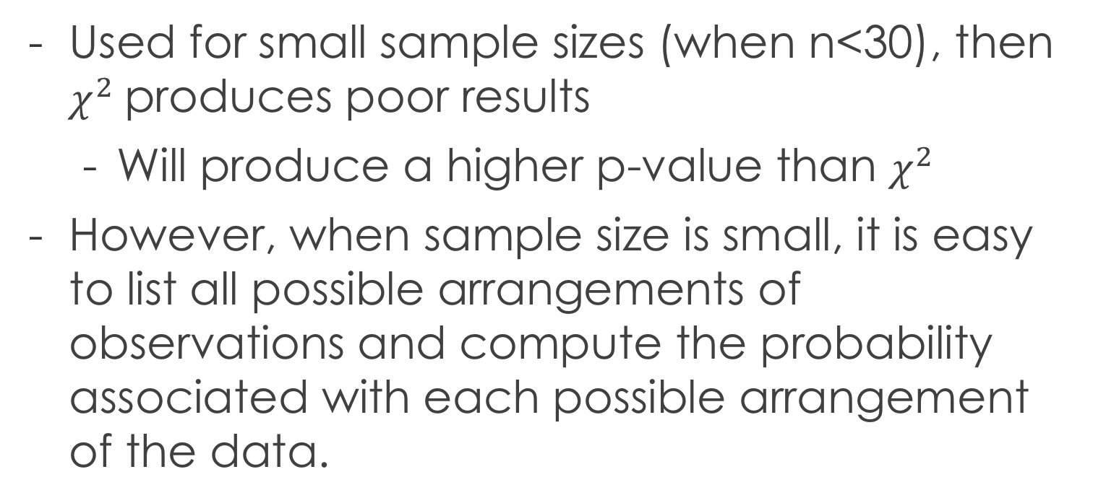
Fisher’s Exact Test
Used for small sample sizes (when n<30), then $χ^{2}$produces poor results
Will produce a higher p-value than $χ^{2}$
However, when sample size is small, it is easy to list all possible arrangements of observations and compute the probability associated with each possible arrangement of the data.
Line 54
https://www.math.wustl.edu/~victor/classes/ma322/r-eg-21.txt

Slide 31
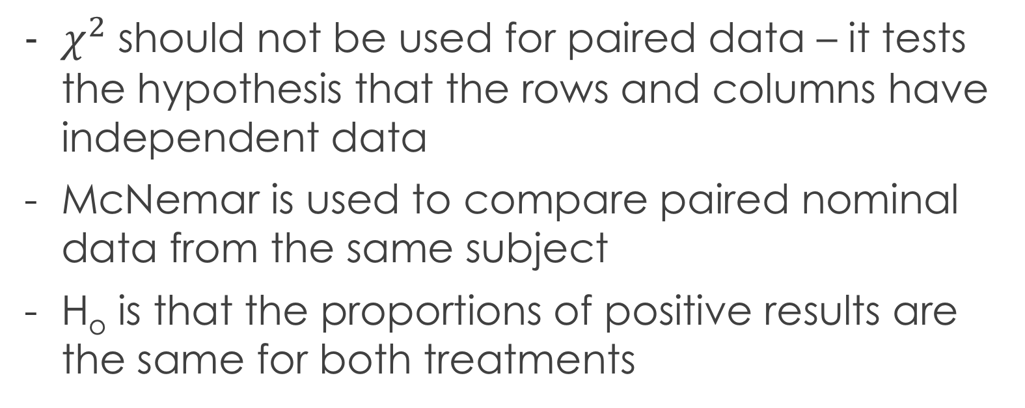
McNemar Test
$χ^{2}$should not be used for paired data – it tests the hypothesis that the rows and columns have independent data
McNemar is used to compare paired nominal data from the same subject
H_{o} is that the proportions of positive results are the same for both treatments
https://stat.ethz.ch/R-manual/R-devel/library/stats/html/mcnemar.test.html

Slide 32
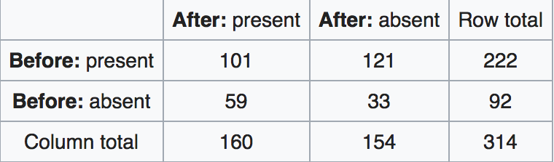
Paired Data
Line 36

Slide 33
Mann Whitney U Test
- Also called Wilcoxon Rank Sum Test
- Compares the difference between two distributions and assumes the samples are independent
- H_{o} : there is no location difference between two population distributions
- Also can be stated that medians of the two populations are the same

Slide 34
Assumptions
- All the observations from both groups are independent of each other,
- The responses are ordinal (i.e., one can at least say, of any two observations, which is the greater),

Slide 35
Alternative Hypotheses
- H_{1a} : population medians are not equal
H_{1b} : the population median of the first group is greater than the second
H_{1c} : the population median of the second group is greater than the first
- H_{1a} leads to a two-tailed W+ test
- H_{1b}& H_{1c} lead to a one-tailed W+ test

Slide 36
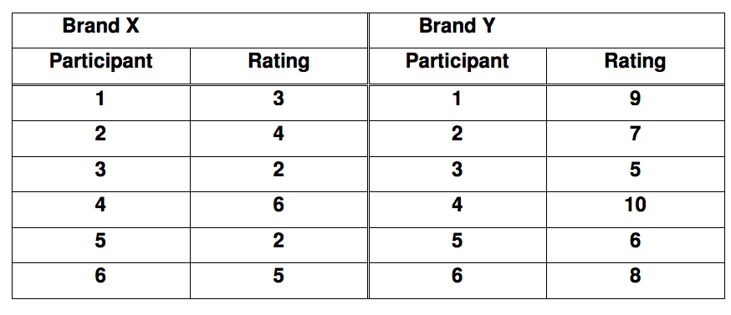
Example
http://users.sussex.ac.uk/~grahamh/RM1web/Mann-Whitney%20worked%20example.pdf
We have two conditions, with each participant taking part in only one of the conditions. The data are ratings (ordinal data), and hence a nonparametric test is appropriate - the Mann-Whitney U test (the nonparametric counterpart of an independent measures t-test).

Slide 37
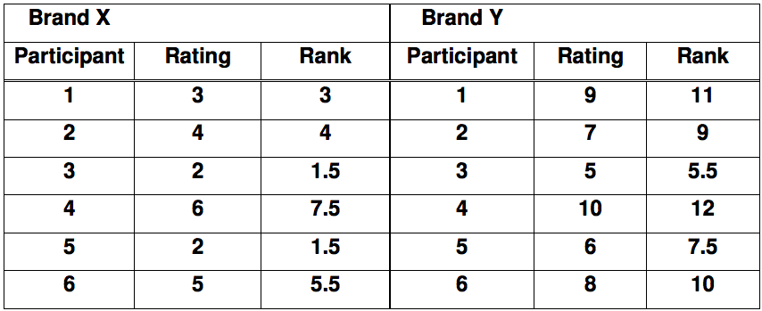
Rank Data

Slide 38
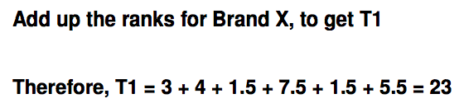
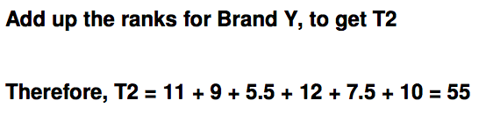
Add ranks (per category)
Calculate the number of participants in each group, and the number of people in the group that gave the larger rank total.
n₁=6
n₂=6
n_{x}=6

Slide 39
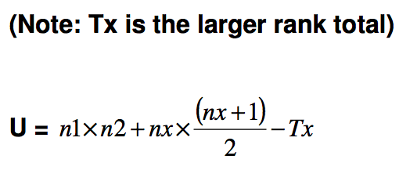
U = 2
Significant!

Slide 40
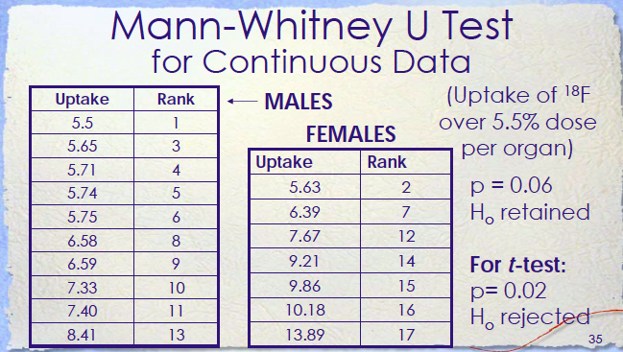
Line 83
Dr. Clarke’s Lecture slides

Slide 41
Wilcoxon Signed Rank Test
Alternative to t-test for non-normally distributed data
Each paired sample is dependent
Data are continuous
Requires only that the paired population be distributed symmetrically about the median

Slide 42
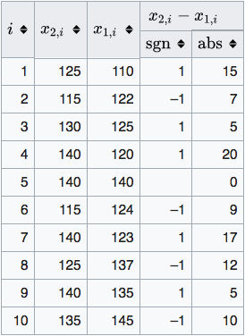
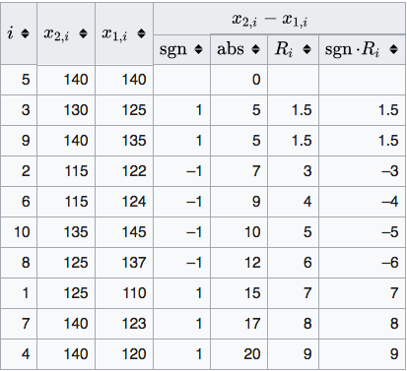
Order by absolute difference

Slide 43
Calculate test-statistic W
Follows distribution:
From example:

Slide 44
-As the size of N increases, the sampling distribution of W comes closer and closer to the outlines of the normal distribution. With a sample of size N=10 or greater, the approximation is close enough to allow for the calculation of a z-ratio, which can then be referred to the unit normal distribution.
http://vassarstats.net/textbook/ch12a.html

Slide 45
Wilcoxon Signed Rank Test in R
- Also known as the Wilcoxon one-sample test, and is similar to one-sample t.test
- Determine whether a woman’s energy intake deviates significantly from 7725 kJ
Line 83

Slide 46
Sign Test
The sign test is a statistical method to test for consistent differences between pairs of observations, such as the weight of subjects before and after treatment.

Slide 47
Sign Test
For comparisons of paired observations (x,y), the sign test is most useful if comparisons can only be expressed as x > y, x = y, or x < y. If, instead, the observations can be expressed as numeric quantities (x = 7, y = 18), or as ranks (rank of x = 1st, rank of y = 8th), then the paired t-test or the Wilcoxon signed-rank test will usually have greater power than the sign test to detect consistent differences.

Slide 48
Example
- A soft drink company has invented a new drink, and would like to find out if it will be as popular as the existing favorite drink. For this purpose, its research department arranges 18 participants for taste testing. Each participant tries both drinks in random order before giving his or her opinion.
http://www.r-tutor.com/elementary-statistics/non-parametric-methods/sign-test

Slide 49
Results
It turns out that 5 of the participants like the new drink better, and the rest prefer the old one.
At .05 significance level, can we reject the notion that the two drinks are equally popular?
The null hypothesis is that the drinks are equally popular. As the p-value turns out to be 0.096525, and is greater than the .05 significance level, we do not reject the null hypothesis.
Line 86

Slide 50
Nonparametric ANOVA
-Nonparametric ANOVA Kruskal-Wallis one-way analysis of variance by ranks
- Friedman test is used to detect differences in treatments across multiple test attempts.
– Similar to the parametric repeated measures ANOVA

Slide 51
Kruskal-Wallis Test
- One-way ANOVA on ranks is a non-parametric method for testing whether samples originate from the same distribution.
- It is used for comparing two or more independent samples of equal or different sample sizes. It extends the Mann–Whitney U test when there are only two groups.

Slide 52
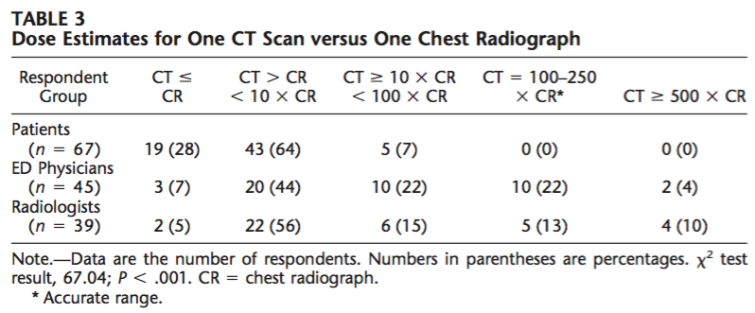
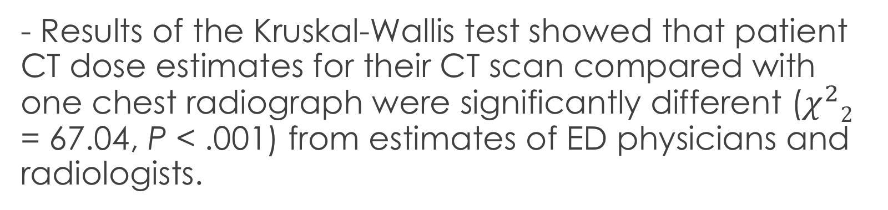
Lee CI, Haims AH, Monico EP, Brink JA, Forman HP (2004): Diagnostic CT Scans: Assessment of Patient, Physician, and Radiologist Awareness of Radiation Dose and Possible Risks. Radiology 231:393–398.
- Results of the Kruskal-Wallis test showed that patient CT dose estimates for their CT scan compared with one chest radiograph were significantly different ($χ^{2}2$ = 67.04, P < .001) from estimates of ED physicians and radiologists.

Slide 53
R Example
The folate data frame has 22 rows and 2 columns. It contains data on red cell folate levels in patients receiving three different methods of ventilation during anesthesia.
The distribution of the test statistic can be worked out based on the idea that, under the hypothesis of irrelevant grouping, the problem reduces to a combinatorial one of sampling the within-group ranks from a fixed set of numbers.
Line 101

Slide 54
Summary
Nonparametric tests are to be used when the assumptions of continuous data and normal distribution do not apply.
Can also be used to evaluate data on nominal and ordinal scales.
In nonparametric tests model structure is not specified a priori, but is instead determined from data.

Slide 55
Summary
The term nonparametric is not meant to imply that such models completely lack parameters; rather, the number and nature of the parameters is not fixed in advance.
Nonparametric models are therefore also called distribution free.
Nonparametric tests have less power than the appropriate parametric tests, but are more robust when the assumptions underlying the parametric test are not satisfied.

Slide 56
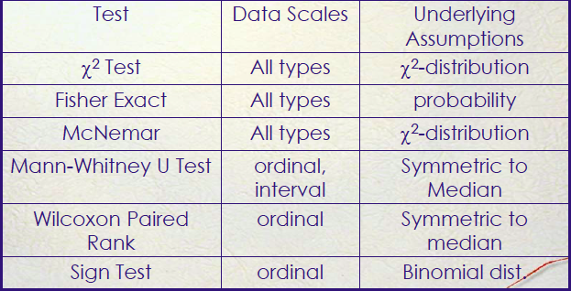
Summary

Slide 57
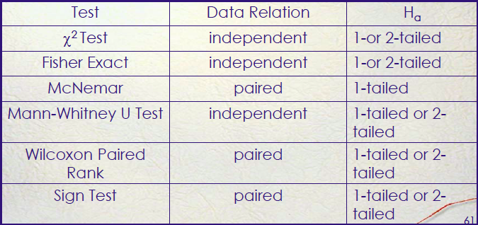
Summary

